Slide 1
SE 181 Introduction to Software Architecture

Slide 2
What is Software Architecture?
The software architecture of a computing system is the structure of the system.
The structure comprises:
Software components
Relationships between the components

Slide 3
Software Architecture: An Abstraction
An architecture is an abstraction of a system that suppresses details of components that do not affect how they:
Use
Are used by
Relate to
Interact with
…other components.

Slide 4
Does Every System have an Architecture?
Yes.
For small systems the architecture may be trivial.
For large systems it definitely exists in the software product, but may not have been documented.

Slide 5
Why is Software Architecture Important?
Communication among stakeholders:
Customers, managers, designers, programmers.
Documentation of early design decisions:
Constraints on implementation
Organizational structure
Guides evolutionary prototyping

Slide 6
Software Architecture Issues
Assignment of functionality to design elements.
Organization and global control structure.
Protocols of communication, synchronization, and data access.
Physical distribution of data and processes.
Selection among design alternatives.

Slide 7
Requirements That Shape Architecture
Quality Attributes
performance,
security,
modifiability,
…
Functional Requirements
what the system must do
Software Architecture
Constraints decisions made externally (e.g., which OS, which devices, etc.)

Slide 8
Architecture Views
Many possible ‘views’ of the architecture
Cf. with buildings – floor plan, external, electrical, plumbing, air-conditioning
Logical view
Process view
Development view
Physical view
Marketecture

Slide 9
Architecture Views (cont’d)
Marketecture
Informal depiction of system’s structure and interactions.
Portray the design philosophies embodied in the architecture.
Every system should have a marketecture:
Easy to understand.
Helps discussion during design, build, review, sales (!) activities.

Slide 10
Designing the Logical Architecture
The logical view is used to decompose systems into logical components that represent the structural integrity that supports functional and non-functional requirements.
The logical view can be modeled using:
Component diagrams
Class diagrams
Box-and-line diagrams

Slide 11
Logical Architecture

Slide 12
Designing the Process Architecture
The process view is used to represent the dynamic or behavioral aspects of software systems, where the main units of analysis are processes and threads.
With this view, the system is decomposed into processes and threads to address design issues that deal with the dynamic flow of control between architectural elements.
The process view can be modeled with UML using:
Sequence diagrams
Communication diagrams

Slide 13
Process Architecture
Based on the received message, the SiteManager stops data collection using the video camera.
Threads in the system using asynchronous communication
<<thread>>
m3: VideoManager
4. stopCollection ()
<<thread>>
<<thread>>
1. receiveMsg(msg)
comm: CommMgr
m2: SensorMgr
m1: SiteManager
4. startCollection ()
2. sendMsg(ACK)
3. update(msg)
uiManager : Observer
Based on the received message, the SiteManager initiates data collection using the sensors.
The SiteManager uses the CommMgr to receive a message. After receipt, the SiteManager sends an immediate ACK response, to indicate that the message is received. After that, it updates the user interface to display the receipt of the message.

Slide 14
Designing the Development Architecture
The development view of software systems represents the software development configuration aspects of the software system.
The main units of decomposition are actual physical files and directories.
This view can be used to analyze the system from the perspective of how logical components map to physical files and directories.

Slide 15
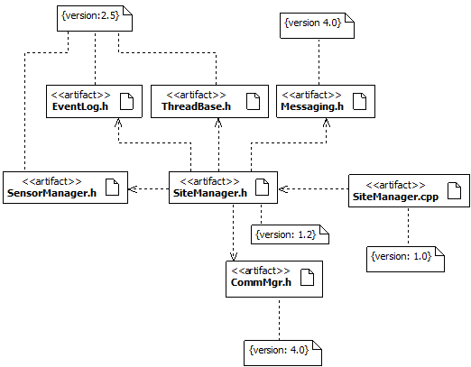
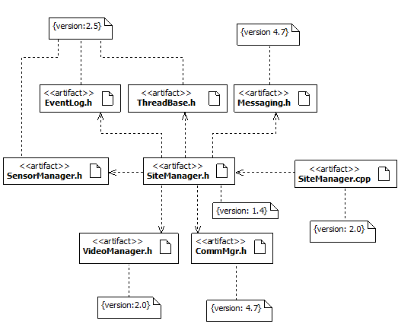
Development Architecture
Notice how versions change with the addition of new functionality!
Version 1.0
Version 2.0
Version 1 of the SiteManager
Version 2 of the SiteManager
Version 1.0 is used by a specific customer that does not require video capture capabilities.
Version 2.0 is used by a specific customer that requires video capture capabilities.

Slide 16
Designing the Physical Architecture
The physical view represents the deployment aspects of software systems.
The main elements of analysis are nodes, connections between nodes, and the mapping of artifacts to these nodes.
This view can be used to model the run-time dependencies of the system.
The physical view can be modeled in UML using deployment diagrams.

Slide 17
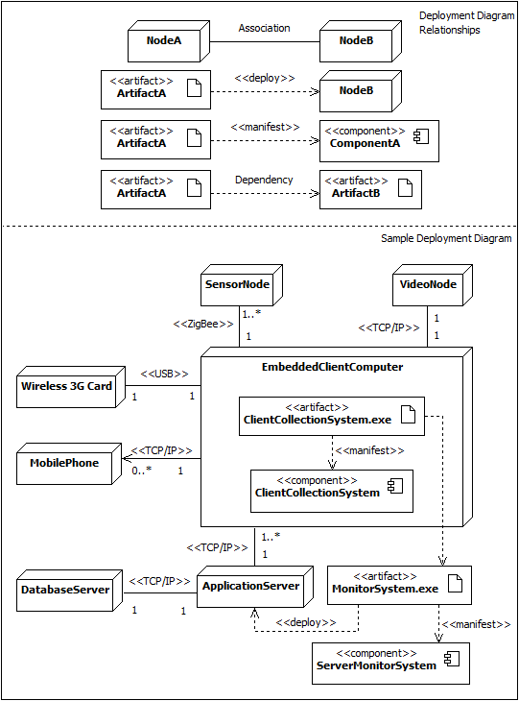
Designing the Physical Architecture

Slide 18
Architectural Styles of Software Systems

Slide 19
Architectural Styles
An Architectural Style defines a family of systems in terms of a pattern of structural organization. It determines:
The vocabulary of components and connectors that can be used in instances of that style
A set of constraints on how they can be combined. For example, one might constrain the execution semantics (e.g., processes execute sequentially).

Slide 20
Describing an Architectural Style
The architecture of a specific system is a collection of:
Components that perform some computation.
Procedures
Modules
Processes
Tools
Databases
Connectors that define the interactions between these components.
Procedure calls
Event broadcasts
Database queries
Pipes

Slide 21
Some Common Styles
Traditional, language-influenced styles
Main program and subroutines
Object-oriented
Hierarchical
Layered
Client-server
Data-flow
Batch sequential
Pipe and filter
Shared memory
Blackboard
Interpreter
Interpreter
Mobile code
Implicit invocation
Event-based
Publish-subscribe
“Derived” styles
CORBA

Slide 22
Hierarchical Styles
Layered Style
Client-Server

Slide 23
Layered Style
Hierarchical system organization
“Multi-level client-server”
Each layer exposes an interface (API) to be used by above layers
Each layer acts as a
Server to layers “above”
Client to layer(s) “below”
Components are typically collections of procedures.
Connectors are typically procedure calls under restricted visibility.
Example: operating systems
Virtual machine style results from fully opaque layers

Slide 24
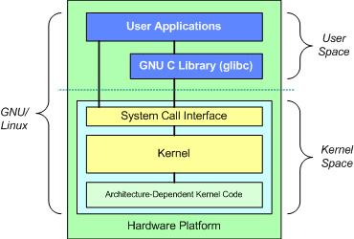
The Layered Structure of an OS

Slide 25
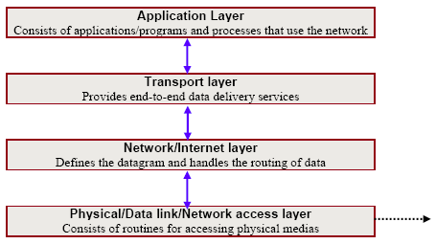
The Layered Structure of TCP/IP

Slide 26
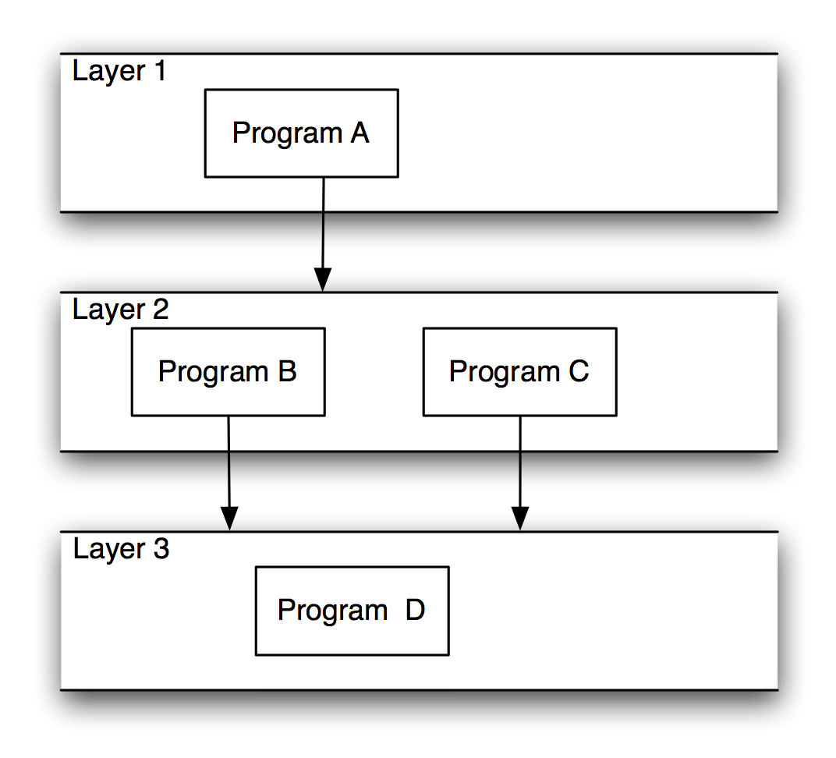
Strict vs. Non-strict Layering
Strict Layering
Non-strict Layering

Slide 27
Layering Advantages/Disadvantages
Advantages
Clear dependence structure benefits evolution
Lower layers are independent from the upper layers
Upper layers can evolve independently from the lower layers as long as the interface semantics are preserved.
Reuse
Standardized layer interfaces for libraries and frameworks.
Disadvantages
Performance requirements may force the coupling of high-level functions to their lower level implementations.
Not all systems are easily structured in layers.
Suitable for applications that involve distinct classes of services that can be organized hierarchically.

Slide 28
Client-Server Style
Components are clients and servers
Servers do not know the number or the identities of the clients
Clients know server’s identity
Connectors are RPC-based network interaction protocols

Slide 29
Client-Server Flavors
Client 1
Client 2
Client N
...
Network
File Server
Database Server
Object Server

Slide 30
Client-Server Flavors (cont’d)
File Server:
Primitive form of data service.
Useful for sharing files across a network.
The client passes requests for files over the network to the file server.
Database servers:
More efficient use of distributing power than file servers.
Client passes SQL requests as messages to the DB server; results are returned over the network to the client.
Query processing done by the server.
Transaction DB servers also available.

Slide 31
Client-Server Flavors (cont’d)
Object Servers:
Objects work together across machine and network boundaries.
ORBs allow objects to communicate with other across the network.
IDLs define interfaces of objects that communicate via the ORB.
ORBs are the evolution of the RCP.

Slide 32
RPCs vs. ORBs
call foo
Server
Client
Server
Object X Object Y
Client
Code
Code
Code
call foo
Data
call foo
on
Object X
call foo
on
Object Y
Data
Data
execute foo
RPC Mechanism
Object Request Broker
1) Remote Procedure Call (RPC)
2) Object Request Broker

Slide 33
Client-Server Advantages/Disadvantages
Advantages
Straightforward distribution of data.
Transparency of location.
Mix and match heterogeneous platforms.
Easy to add new servers or upgrade existing servers.
Disadvantages
Performance of the system depends on the performance of the network.
Tricky to design and implement C/S systems.
Unless there is a central register of names and services, it may be hard to find out what services are available.

Slide 34
When to use the Client-Server Style
Use it when:
Data centralization is desirable and powerful server serves multiple clients.
Clients primarily perform simple user interface tasks.
Avoid it when:
Centrality presents a single-point-of-failure risk.
Network bandwidth limited.
Client machine’s capabilities rival, or exceed, the server’s

Slide 35
Dataflow Styles
Batch Sequential
Pipe and Filter

Slide 36
Pipe and Filter Style
Components are filters
Transform input data streams into output data streams
Possibly incremental production of output
Connectors are pipes
Conduits for data streams
Style invariants
Filters are independent (no shared state)
Filter has no knowledge of up- or down-stream filters

Slide 37
Pipe and Filter Style (cont’d)
Examples
UNIX shell
Traditional compilers
Example: ls invoices | grep -e August | sort
Variations
Named pipes — pipes beyond stdin / stdout

Slide 38
Face Identity Application
What does a possible architecture look like for a s/w application that processes videos and identifies faces?
Assume we have the following software components that help us identify the identity of an individual in a video clip:
A s/w component that accesses videos (with audio) from YouTube (YoutubeManager).
A s/w component that determines if a face is in the video (FaceDetection).
A s/w component that detects the identity of the person from the detected face (FaceRecognition).
A s/w component that produces a report of the results (IdenityManager).

Slide 39
The Face Identity Application
Transformed data containing only the information from detected faces!
Big video file!
Transformed data containing only the results from the recognition process, e.g., a report of identity!
Wanted!
Youtube Manager
Face Detection
Face Recognition
Identity Manager
Joe Developer
Wanted!

Slide 40
Pipe and Filter Style (cont’d)
filter
pipes

Slide 41
Pipe and Filter Advantages/Disadvantages
Advantages
Easy to understand: system behavior is a succession of component behaviors
Filter addition, replacement, and reuse
Possible to hook any two filters together
Concurrent execution
Disadvantages
Interactive applications
Not conducive when complex data structures must be exchanged between filters.
Excessive parsing and unparsing leads to loss of performance.
Batch organization of processing and increased complexity in writing the filters.

Slide 42
When to use it
Use it when:
Filters already exist and are useful in more than one application
Data structures easily serializable
Avoid it when:
Interaction between components is required
Exchange of complex data structures between components is required.

Slide 43
Shared Memory Styles
Blackboard

Slide 44
Blackboard Style
Two kinds of components
Central data structure — blackboard
Components operating on the blackboard
System control is entirely driven by the blackboard state
Examples
Integrated software environments
Compiler architecture

Slide 45
Blackboard Style (cont’d)
Memory Access
Computation
Shared Data
Memory

Slide 46
Blackboard Style (cont’d)
Specializations:
Data structure in memory.
Data structure on disk.
Changes to the data structure trigger computations.
Concurrent computations and data access.

Slide 47
Blackboard Style (cont’d)
Advantages:
Efficient way to store “large” amount of data.
Sharing model is published as the repository schema.
Centralized management of data.
Disadvantages:
Must agree of a data model a priori.
Difficult to distribute data.
Data evolution is expensive.

Slide 48
When to use it
Use it when:
All calculation centers on a common data structure.
Order of processing dynamically determined and data-driven.
Avoid it when:
Programs deal with independent parts of the common data.
Interface to common data susceptible to change.
When interaction between programs require complex regulation.

Slide 50
Architecture of a Compiler
The architecture of a system can change in response to improvements in technology.
This can be seen in the way we think about compilers.

Slide 51
Early Compiler Architectures
In the 1970s, compilation was regarded as a sequential (batch sequential or pipeline) process:
text
Lex
Syn
Sem
Opt
CGen
code

Slide 52
Early Compiler Architectures (cont’d)
Most compilers create a separate symbol table during lexical analysis and used or updated it during subsequent passes.
Symbol Table
text
Lex
Syn
Sem
Opt
CGen
code

Slide 53
Modern Compiler Architectures
Later, in the mid 1980s, increasing attention turned to the intermediate representation of the program during compilation.
Symbol Table
text
code
Lex
Syn
Sem
Opt
CGen
Attributed
Parse Tree

Slide 54
Hybrid Compiler Architectures
The new view accommodates various tools (e.g., syntax-directed editors) that operate on the internal representation rather than the textual form of a program.
Architectural shift to a repository style, with elements of the pipeline style, since the order of execution of the processes is still predetermined.

Slide 55
Hybrid Compiler Architectures
Lex
Syn
Sem
Opt
Cgen
Attributed
Parse Tree
Symbol Table
Edit
Flow

Slide 56
Interpreter Styles
Interpreter
Mobile Code

Slide 57
Interpreter Style
An interpreter is a program capable of parsing and executing statements written in some other programming language.
Essentially, an interpreter creates a virtual machine.
Therefore, the interpreter style is suitable for applications in which the most appropriate language or machine for executing the solution is not directly available.

Slide 58
Interpreter Style Examples
Programming Language Translators:
Java
Python
Command Language Processors:
Unix shell
Scripting Languages:
Awk
Perl
Rule Based Systems:
Prolog
Coral

Slide 59
Interpreter Style (cont’d)
Components: include one state machine for the execution engine and three memories:
current state of the execution engine
program being interpreted
current state of the program being interpreted
Connectors:
procedure calls
direct memory accesses.

Slide 60
Interpreter Style (cont’d)
Memory
Current State
of
Program Being
Interpreted
Program
Being
Interpreted
inputs
Computation
State Machine
store
Execution
Engine
selected
instruction
Current
State of
Execution
Engine
outputs
Selected
data (fetch)

Slide 61
Interpreter Style Advantages/Disadvantages
Advantages
Simulation of non-implemented hardware.
Facilitates portability of application or languages across a variety of platforms.
Disadvantages
Extra level of indirection slows down execution.

Slide 62
Java Architecture (cont’d)
Java
Source
Code
Java
Compiler
Java Virtual
Machine
Java
Bytecode
Operating
System

Slide 63
Java Architecture (cont’d)
Java
Source
Code
Bytecode
Verifier
Class
Loader
Java
Compiler
INTERNET
Java Virtual Machine
Just In Time
Compiler
Java
Bytecode
Operating System

Slide 64
Implicit Invocation Styles
Event-based
Publish and Subscribe

Slide 65
Implicit Invocation Styles
Event announcement instead of method invocation
“Listeners” register interest in and associate methods with events.
System invokes all registered methods implicitly.
Component interfaces are methods and events
Style invariants
“Announcers” are unaware of their events’ effects.
No assumption about processing in response to events.

Slide 66
Implicit Invocation Styles (cont’d)
Instead of invoking a procedure directly ...
A component can announce (or broadcast) one or more events.
Other components in the system can register an interest in an event by associating a procedure with the event.
When an event is announced, the broadcasting system (connector) itself invokes all of the procedures that have been registered for the event.

Slide 67
Implicit Invocation Styles (cont’d)
Suitable for applications that involve loosely-coupled collection of components, each of which carries out some operation and may in the process enable other operations.
Particularly useful for applications that must be reconfigured “on the fly”:
Changing a service provider.
Enabling or disabling capabilities.

Slide 68
Implicit Invocation Advantages / Disadvantages
Advantages:
Provides strong support for reuse
any component can be introduced into a system simply by registering it for the events of that system.
Eases system evolution
components may be replaced by other components without affecting the interfaces of other components in the system.
Disadvantages:
When a component announces an event:
It has no idea what other components will respond to it.
It cannot rely on the order in which the responses are invoked.
It cannot know when responses are finished.

Slide 70
Event-Based Style
Independent components asynchronously emit and receive events communicated over event buses.
Sending events does not depend on the state of the receiving application.
receive
send
event
queue

Slide 71
Event-Based Style (cont’d)
Components: Independent, concurrent event generators and/or consumers.
Connectors: Event buses (at least one)
Data Elements: Events – data sent as a first-class entity over the event bus.
Topology: Components communicate with the event buses, not directly to each other.
Variants: Component communication with the event bus may either be push or pull based.
Highly scalable, easy to evolve, effective for highly distributed applications.

Slide 72
Event-Based Advantages/Disadvantages
Advantages
Scalable
Easy to evolve (just add another component).
Components can be heterogeneous (as long as they can communicate with the event bus).
Disadvantages
No guarantee when the event will be processed.

Slide 73
When to use Event-Based
Use it when:
Components are concurrent and independent.
Components heterogeneous and network-distributed.
Avoid it when:
Guarantees on real-time processing of events is required.

Slide 75
Publish-Subscribe Style
Publishers send a single copy of a message addressed to a named topic, or subject.
Subscribers register/deregister to receive specific messages or specific content.
Subscribers listen for messages that are sent to topics that interest them.
The publish–subscribe server then distributes each message sent on a topic to every subscriber who is listening on that topic.

Slide 76
Publish-Subscribe Style (cont’d)
Each topic may also have more than one publisher.
Publishers may appear and disappear dynamically.
Likewise, subscribers can dynamically subscribe and unsubscribe to a topic.
Thus the subscriber set for a topic can change at any time, and this is transparent to the application code.

Slide 77
Publish-Subscribe Style (cont’d)
Components: Publishers, subscribers, proxies for managing distribution.
Connectors: Typically a network protocol is required. Content-based subscription requires sophisticated connectors.
Data Elements: Subscriptions, notifications, published information.
Topology: Subscribers connect to publishers either directly or may receive notifications via a network protocol from intermediaries.
Highly efficient one-way dissemination of information with very low-coupling of components.

Slide 78
Publish-Subscribe with Multicast
Based on
TIBCO
Rendezvous

Slide 79
Publish-Subscribe with Multicast (cont’d)
Each node in the publish–subscribe network runs a daemon process known as rvd.
When a new topic is created, it is assigned a multicast IP address.
When a publisher sends a message, its local rvd daemon intercepts the message and multicasts a single copy of the message on the network to the address associated with the topic.
The listening daemons on the network receive the message, and each checks if it has any local subscribers to the message’s topic on its node.

Slide 80
Publish-Subscribe with Multicast (cont’d)
If so, it delivers the message to the subscriber(s), otherwise it ignores the message.
If a message has subscribers on a remote network, an rvrd daemon intercepts the message and sends a copy to each remote network using standard IP protocols.
Each receiving rvrd daemon then multicasts the message to all subscribers on its local network.

Slide 81
Publish-Subscribe Advantages/Disadvantages
Advantages
Subscribers are independent from each other.
Very efficient one way information dissemination.
Disadvantages
Need special protocols to deal with very high numbers of subscribers.

